Slide 1
A Minor Poject Presentation on workshop portal For Partial fulfilment of B.Tech in Computer Science & Engineering Session (2022-23)
Submitted By :
Abhishek Nagaich (2115990003)
Anvesh Satyarthi (2115990004)
Mohan Singh (2115990011)
Kautuk Gupta (201500334)
Submitted To :
DEPARTMENT OF CSE
UNIVERSITY POLYTECHNIC GLA UNIVERSITY, MATHURA

Slide 2
Overview
Abstract
Introduction
Hardware Requirements:-
Tools and technology used
DFD of the project
Snapshots
Role of Member’s individually
Conclusion

Slide 3
Abstract
This project is to solve some difficulties and problems faced by students and workshop owner. Which are related from their study and business. Every student can show workshop and easily enroll them and enhance our skills.

Slide 4
Introduction
The aim of this project is to provide a separate website for students and organization. In this project we have created a workshop portal. This is very good platform for the user because the user can easily attend the interested seminar, it means if some user wants to join any seminar than user come on workshop portal than he will choose there interested seminar and he will go to the Enroll option than he can easily participate for there interested seminar.

Slide 5
In this workshop portal we are added a two module that is..
(Admin)- In this platform the Admin control all workshop create delete ,rename and all things .
AND
(User)- Those who are interested on particular seminar than the user choose the interested seminar than he will go to the registration option than he registered himself on the schedule time.

Slide 6
Hardware Requirements:-
Processor Intel Celeron/Pentium
1GHz CPU
2 GB RAM
250GB Hard drive/SSD

Slide 7
Tools and technology used
Tools:
Sublime Text: editor is used as an Integrated Development Editor (IDE) like Visual Studio code and Net Beans. The current version of Sublime Text editor is 3.0 and is compatible with various operating systems like Windows, Linux and Mac OS
XAMPP is an abbreviation for cross-platform, Apache, MySQL, PHP and Perl, and it allows you to build WordPress site offline, on a local web server on your computer. This simple and lightweight solution works on Windows, Linux, and Mac – hence the “cross-platform” part. version is 7.3.25.

Slide 8
Tools and technology used
PHP stands for Hypertext Preprocessor PHP is a language used to develop interactive and dynamic content on the web and it is often used together with the Apache web server version is 6.0.
SQL: - SQL is a structured query language used for querying database.
HTML: - It is used for giving eye catching look to the website. And also providing easy touse GUI.
CSS: - CSS is cascading style sheet which is used to give designer look to HTML using the externalfile.
Java script: - Java script is used for client side scripting which can help in using validation on the website and many more otherfunctions.
Bootstrap

Slide 9
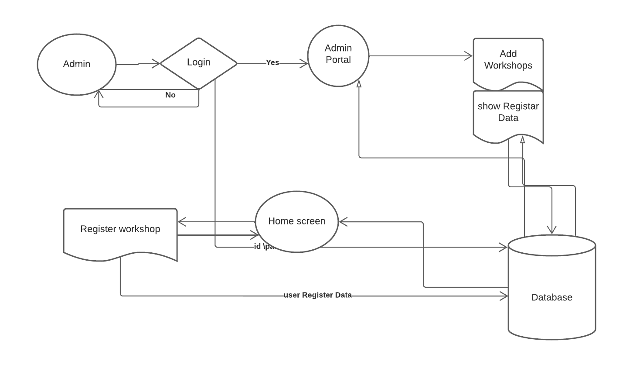
DFD of project
1- level DFD

Slide 10
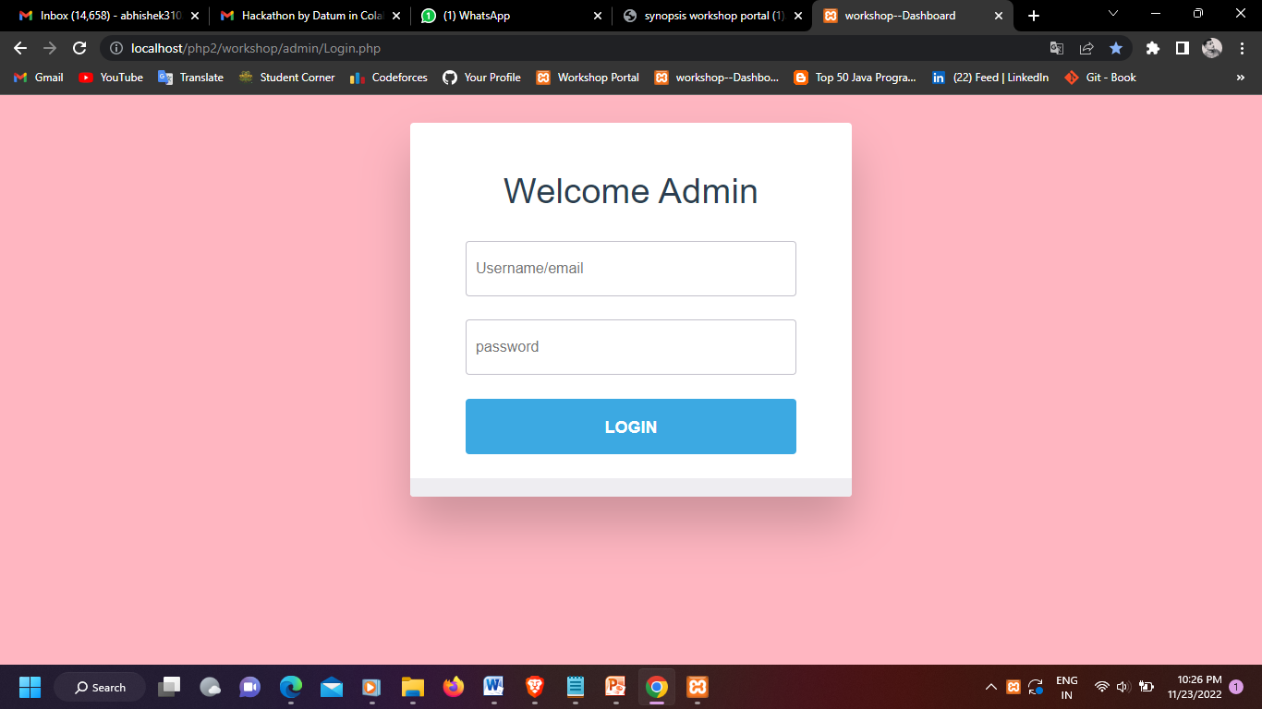

Slide 11
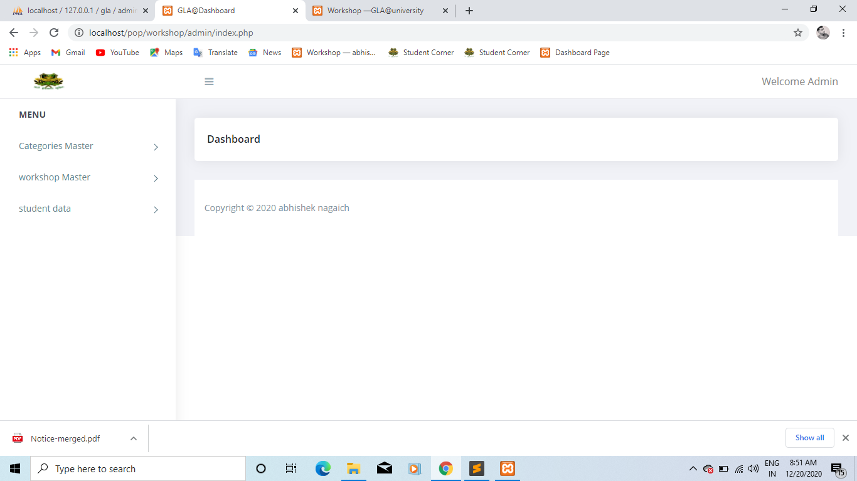

Slide 12
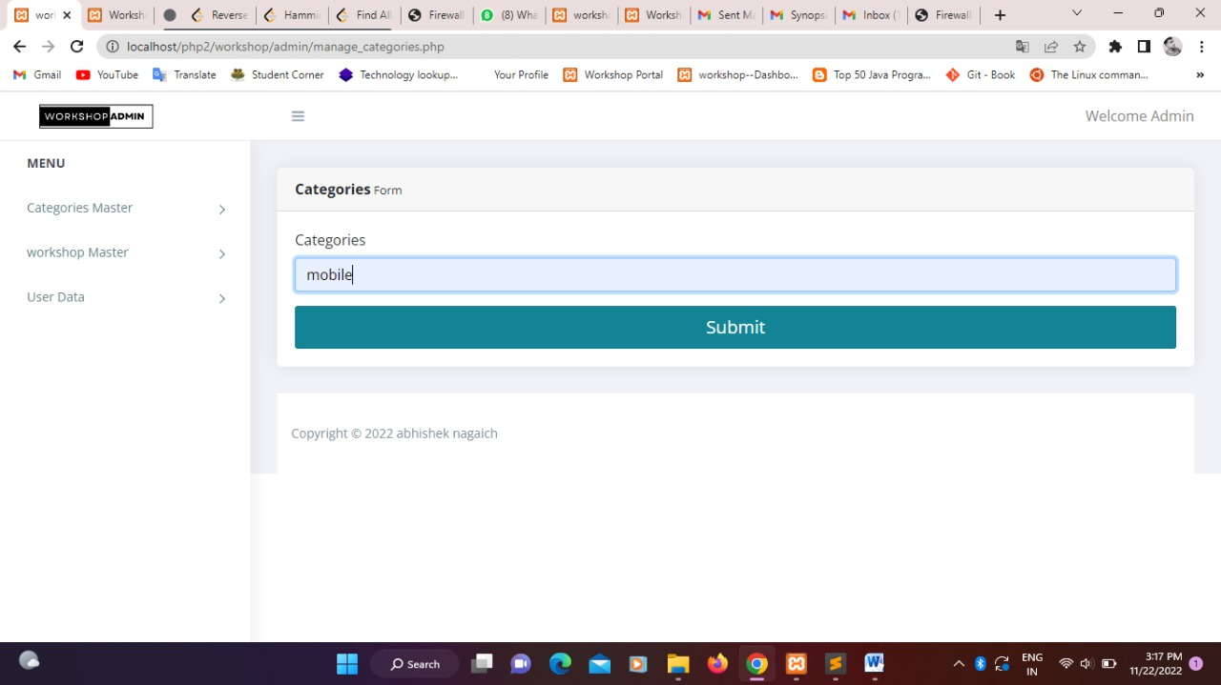

Slide 13
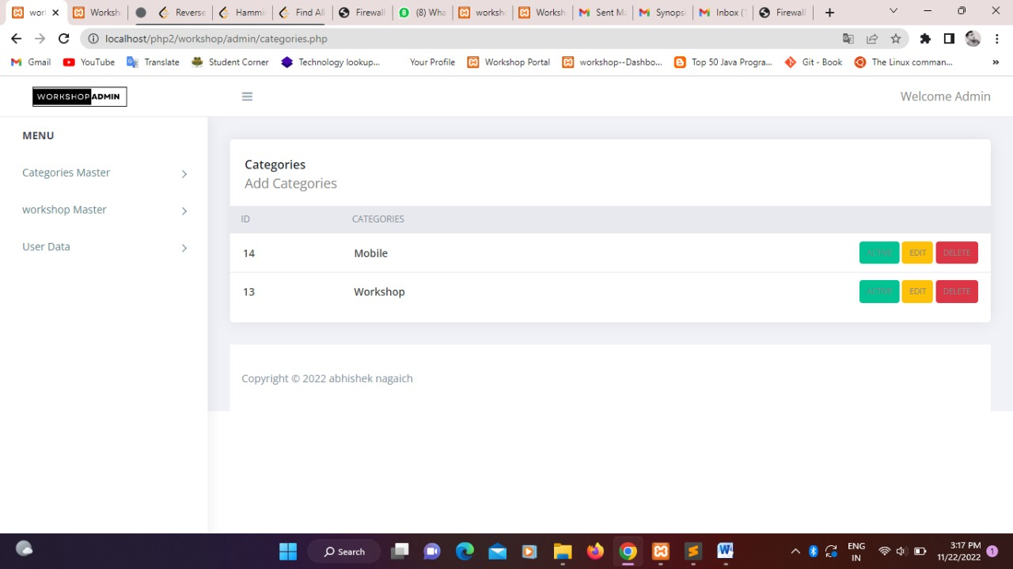

Slide 14
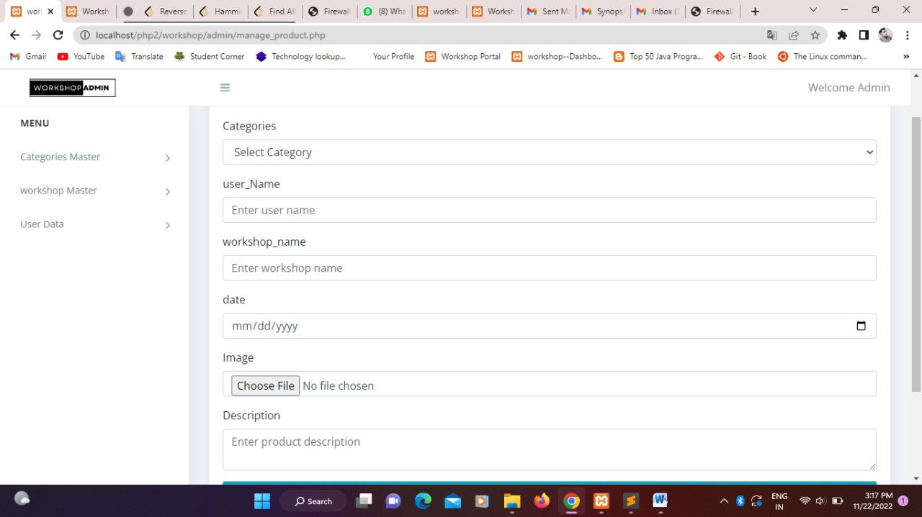

Slide 15
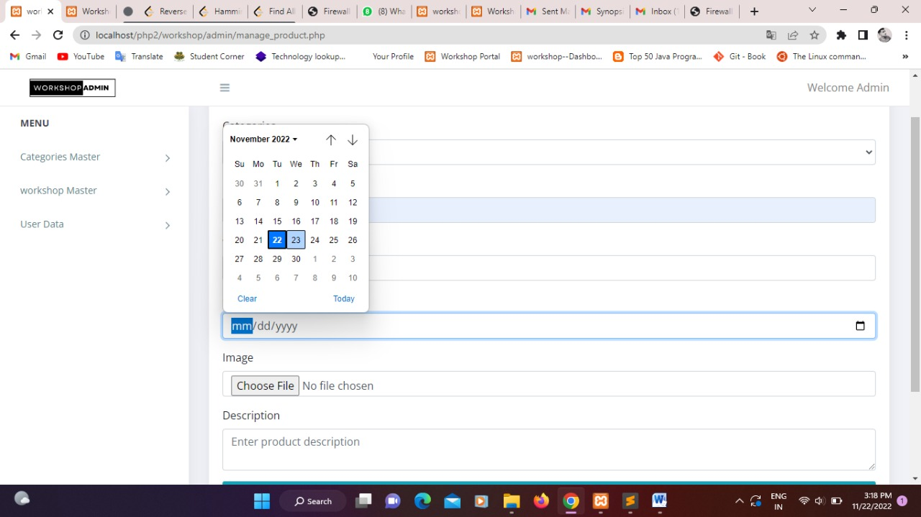

Slide 17
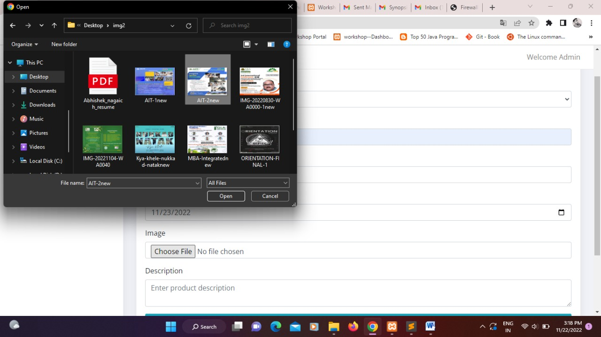

Slide 18
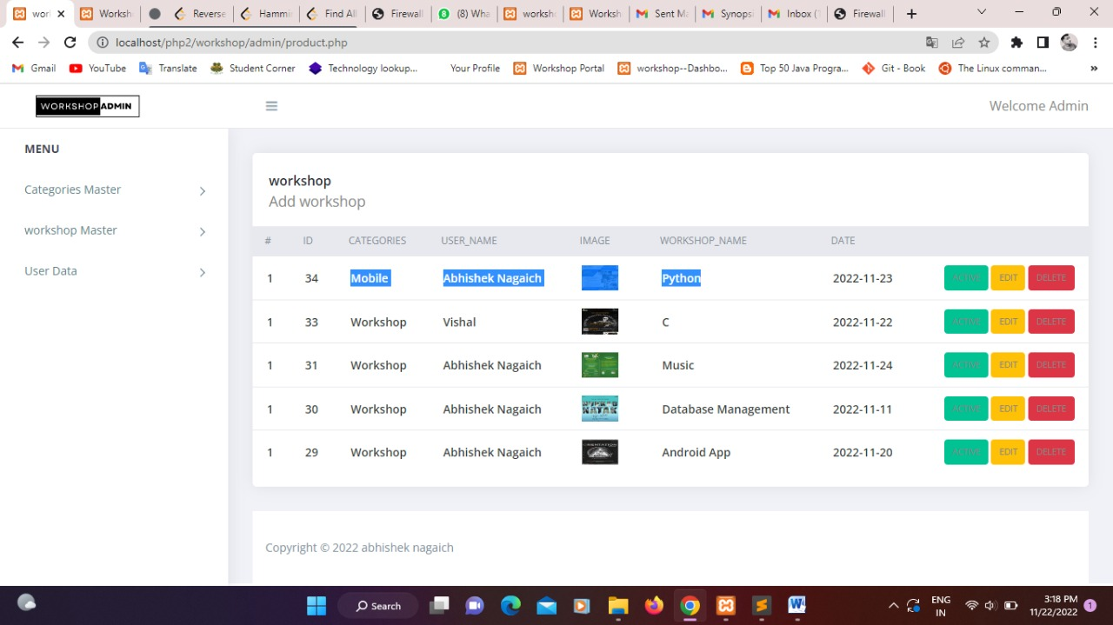

Slide 19
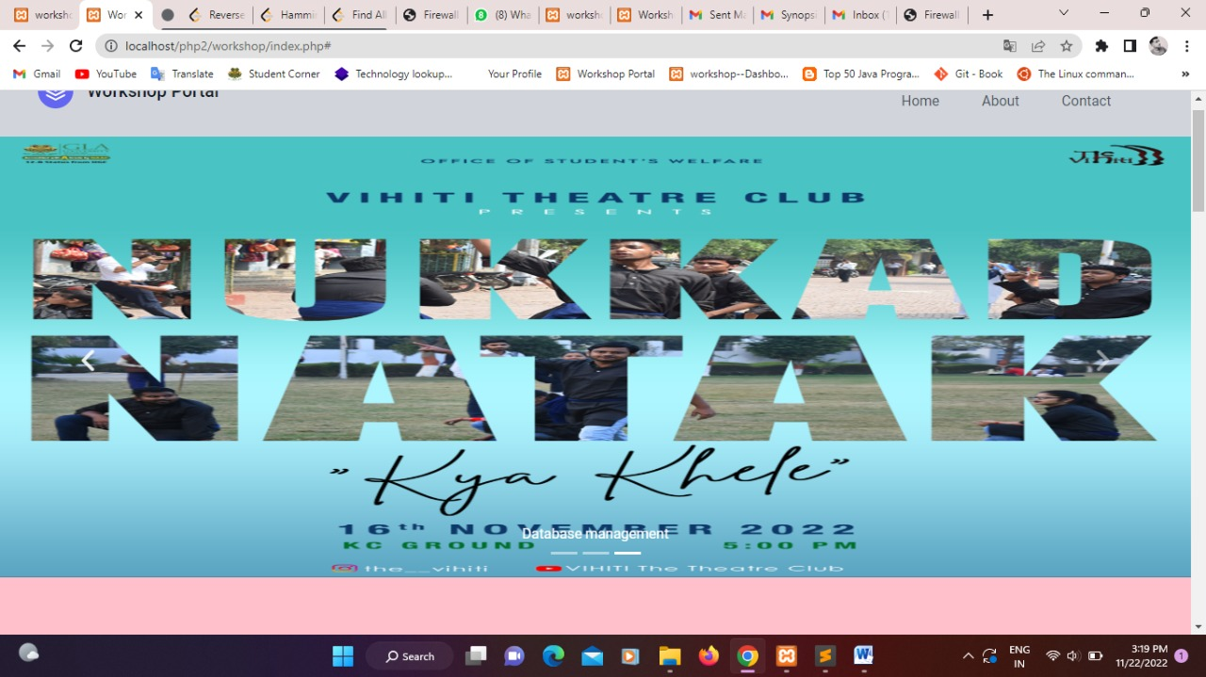

Slide 20
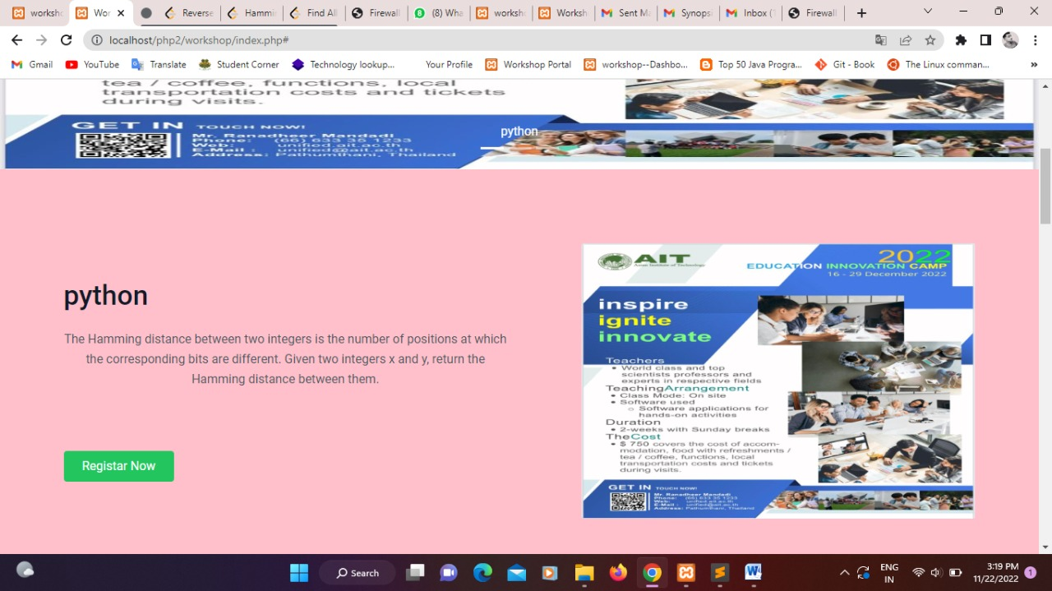

Slide 21
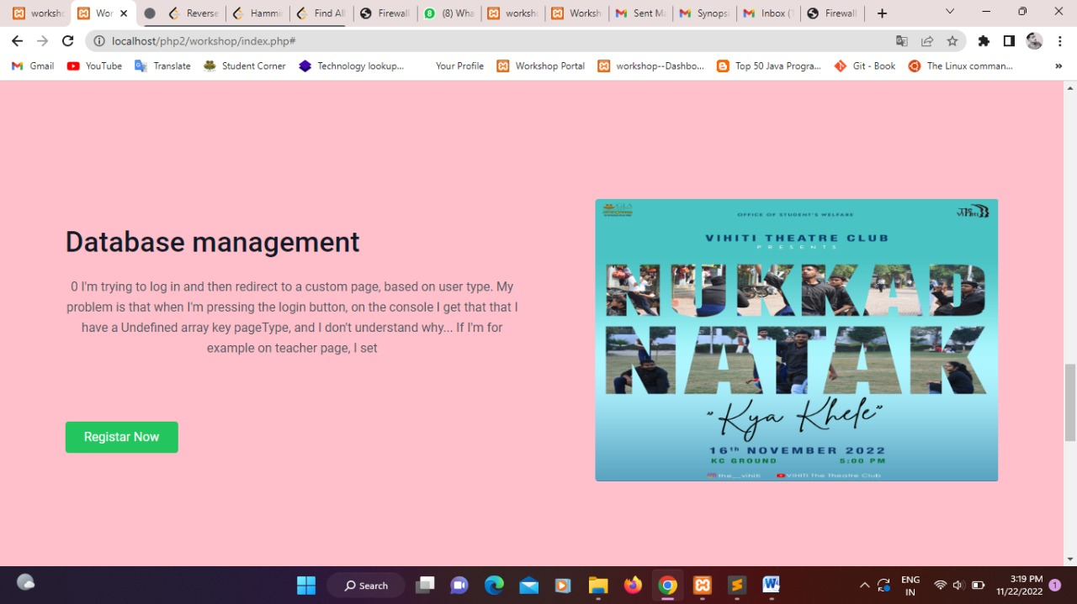

Slide 22
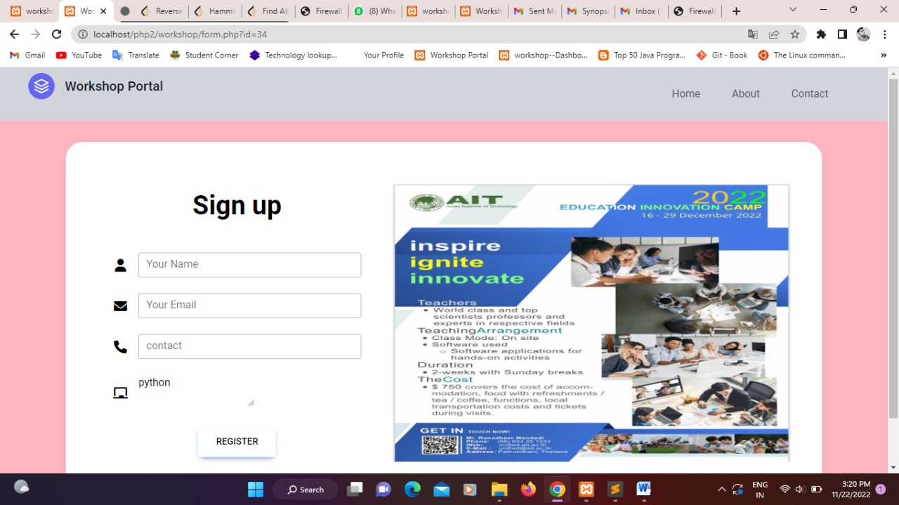

Slide 23
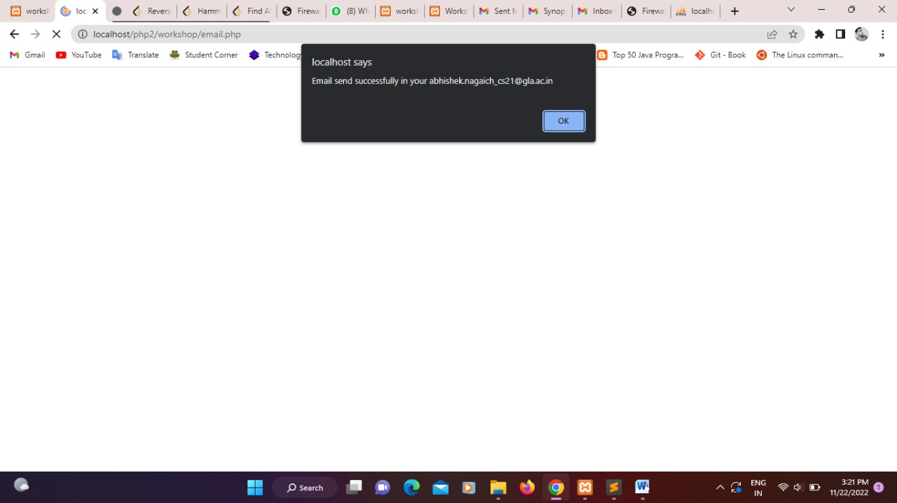

Slide 24
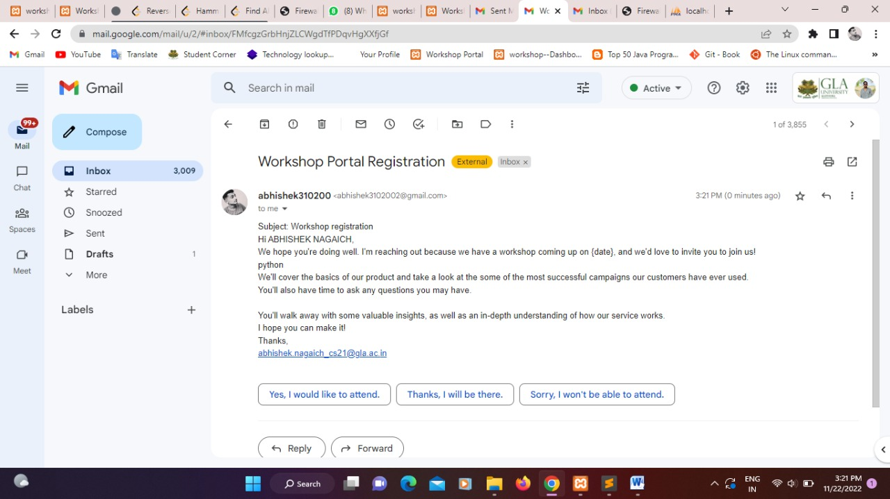

Slide 25
Conclusion
According to my project i conclude that, this project is totally based on workshop portal and this portal which helps to take the all seminars and workshop are available on this portal and include the time and date also. so, this project which helps to attend the seminars and workshops easily. and provide the all course seminars content are available.

Slide 26
Thank You!!!

